Slide 1

11.1.24

Slide 2
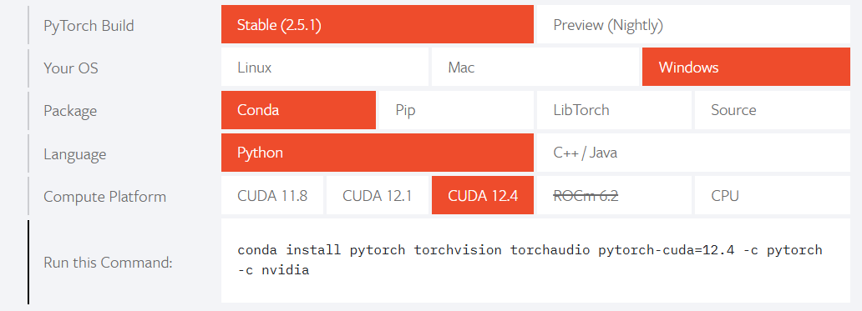
PyTorch Install (if you haven’t already)
If you want to use a local GPU, you need to install CUDA Toolkit
PyTorch only uses the 12.4 and earlier releases
Instructions: https://pytorch.org/

Slide 3
Learning Objectives
AutoGrad
Tensors
Neural Network Architectures
Pretrained
Training

Slide 4
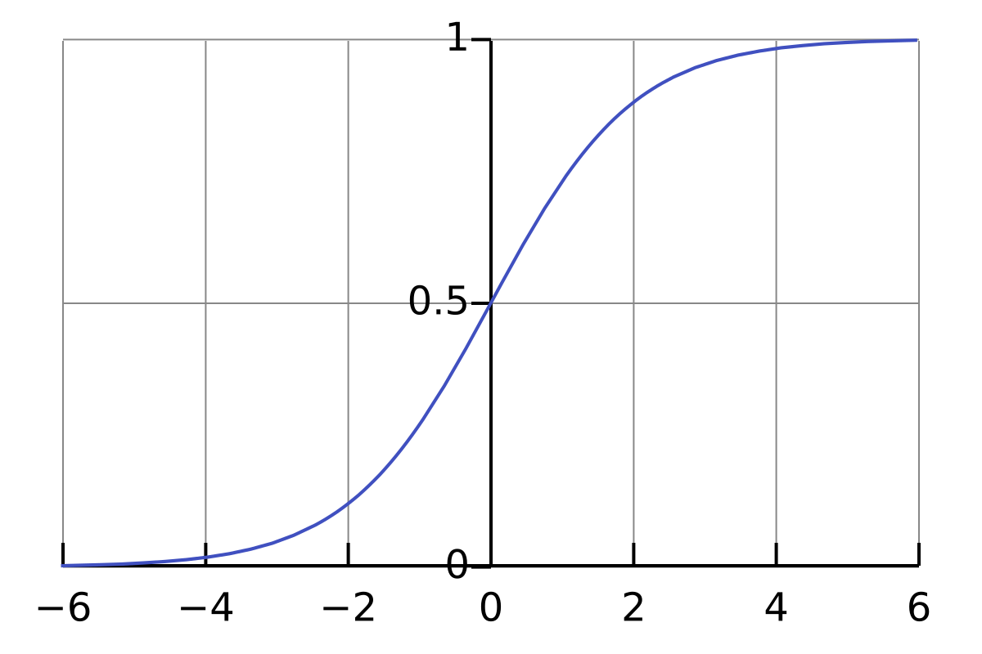
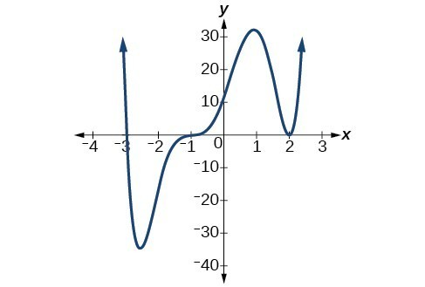
Neural Networks
Universal Approximators
Compositions and linear mixing of simple functions to approximate complex ones
a
b
+
c
=

Slide 5
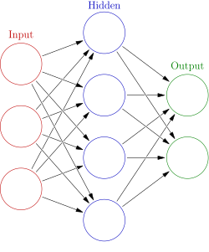
Neural Networks
2 Parts:
Activation function (nonlinearity)
Connection weights (matrices)
(I’m including “bias” terms here)
We want to optimize the weights

Slide 6

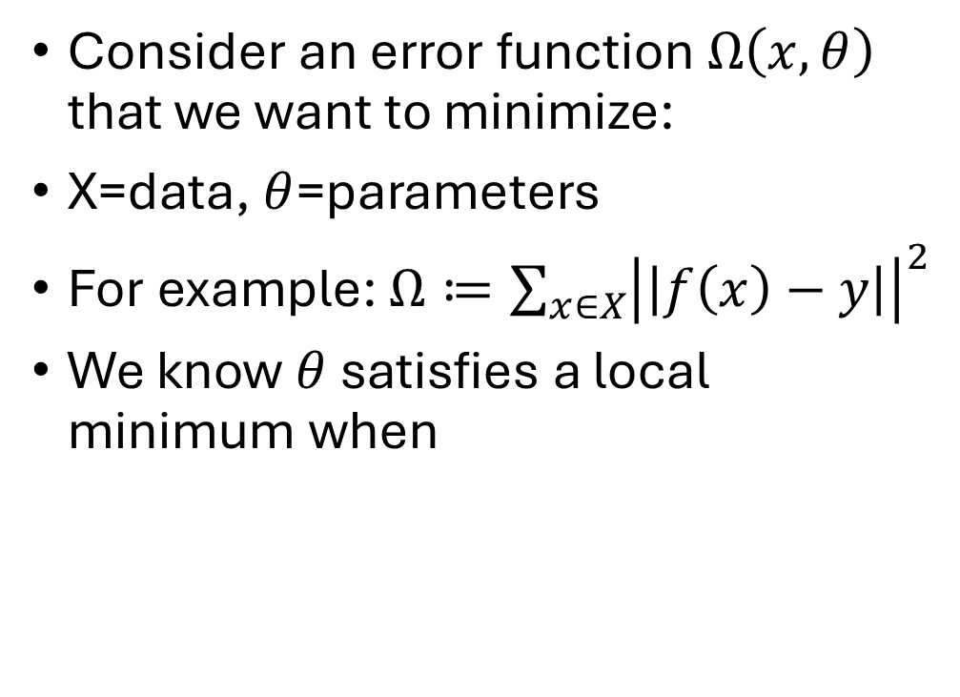

Gradients
Consider an error function $Ω\left(x,θ\right)$ that we want to minimize:
X=data, $θ$=parameters
For example: $Ω≔\sum_{x∈X}{{\left|\left|f\left(x\right)−y\right|\right|}^{2}}$
We know $θ$ satisfies a local minimum when
$$∇_{θ}Ω=\left[\begin{matrix}\frac{∂Ω}{∂θ_{1}} \\ ⋮ \\ \frac{∂Ω}{∂θ_{n}}\end{matrix}\right]=0$$
$$∇Ω$$

Slide 7
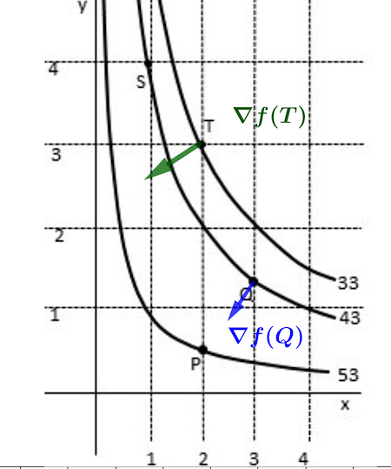
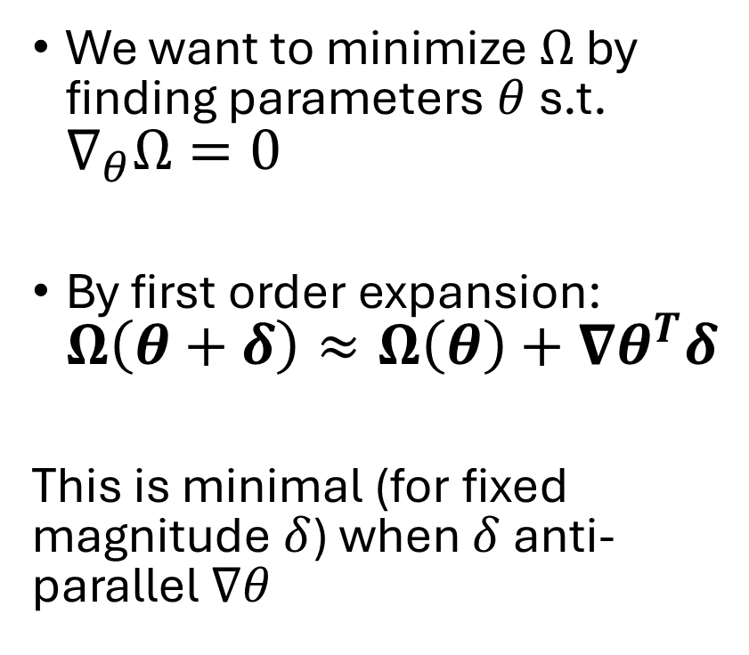
Gradients
We want to minimize $Ω$ by finding parameters $θ$ s.t. $∇_{θ}Ω=0$
By first order expansion: $Ω\left(θ+δ\right)≈Ω\left(θ\right)+∇θ^{T}δ$
This is minimal (for fixed magnitude $δ$) when $δ$ anti-parallel $∇θ$

Slide 8
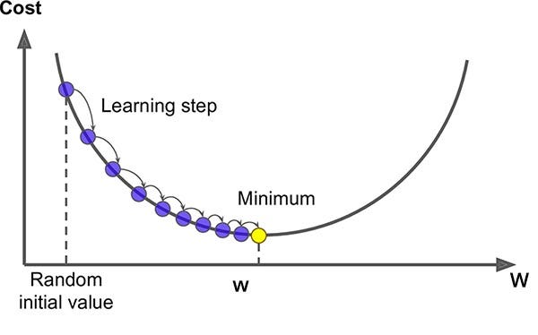
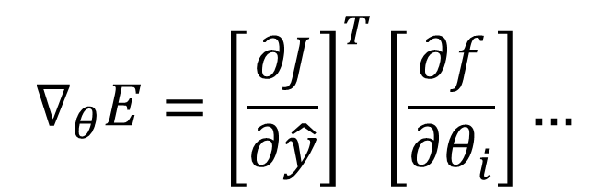
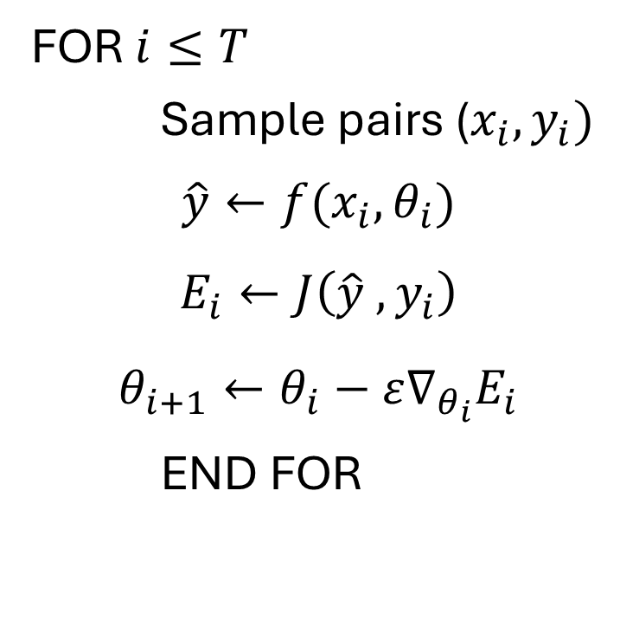
Stochastic Gradient Descent Algorithm
FOR $i≤T$
Sample pairs ($x_{i},y_{i})$
$$\hat{y}←f(x_{i},θ_{i})$$
$$E_{i}←J\left(\hat{y} , y_{i}\right)$$
$$θ_{i+1}←θ_{i}−ε∇_{θ_{i}}E_{i}$$
END FOR
$$∇_{θ}E={\left[\frac{∂J}{∂\hat{y}}\right]}^{T}\left[\frac{∂f}{∂θ_{i}}\right]…$$

Slide 9
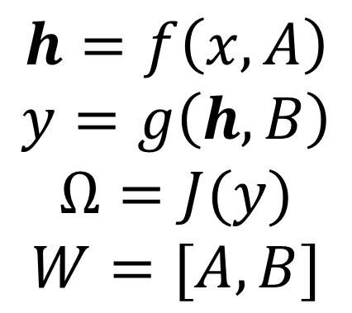
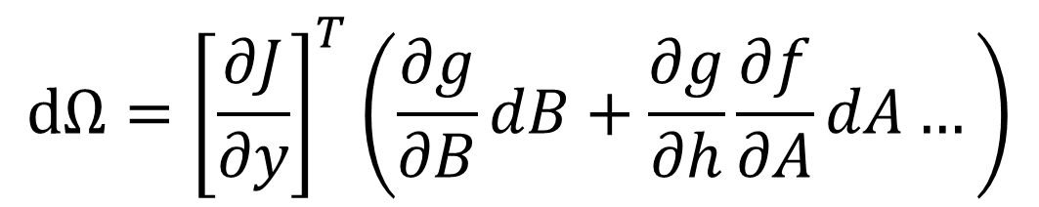
Calculating Gradients
Neural networks are a composition of layers
Each layer is a function
The derivative is calculated via chain-rule
$$h=f\left(x,A\right)$$
$$y=g\left(h,B\right)$$
$$Ω=J(y)$$
$$W=[A,B]$$
$$dΩ={\left[\frac{∂J}{∂y}\right]}^{T}\left(\frac{∂g}{∂B}dB+\frac{∂g}{∂h}\frac{∂f}{∂A}dA…\right)$$

Slide 10
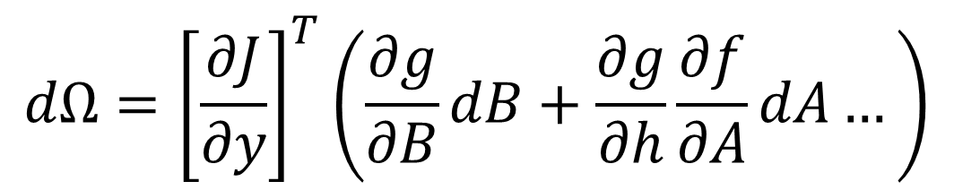
BackPropagation
Predictions
When we make predictions we go forward through the network
The final derivative is a gradient (since cost is 1d), but all intermediates are Jacobians (multidimensional).
Solution: Start with the last derivative (vector) and recurse backwards through the layers.
Error Gradients
$$dΩ={\left[\frac{∂J}{∂y}\right]}^{T}\left(\frac{∂g}{∂B}dB+\frac{∂g}{∂h}\frac{∂f}{∂A}dA…\right)$$

Slide 11
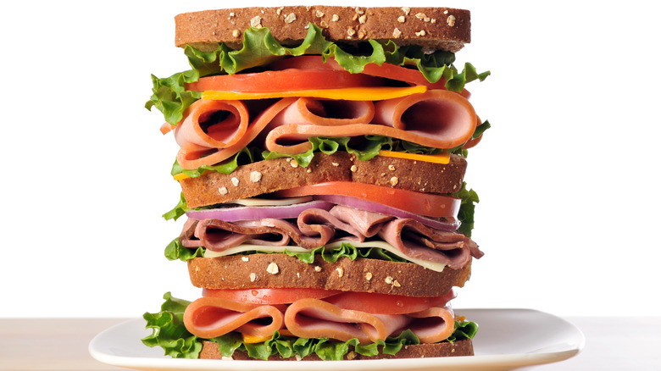
It’s just like a…

Slide 12
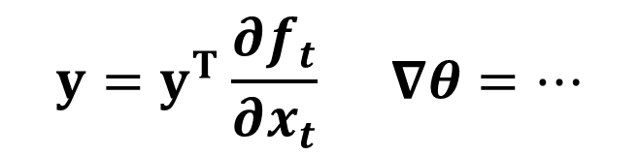

Recursive Program!
def func(x, t=0):
if cond and t<tMax:
y = func(x,t+1)
return y
Layer 0
$$x_{t}=f\left(x_{t},θ\right)$$
Layer 1
Layer 2
Layer 2
$$y=y^{T}\frac{∂f_{t}}{∂x_{t}} ∇θ=…$$
Layer 1
Layer 0

Slide 13
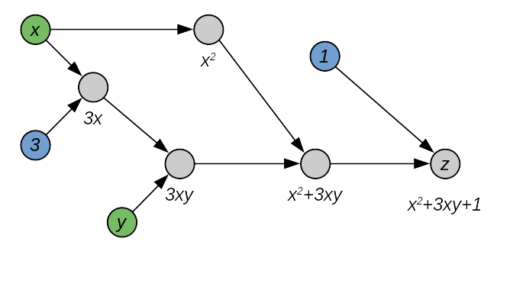
Automatic differentiation / AutoGrad
Every computer operation is made of lots of little basic operations.
Complicated functions like tanh(x) are still computed using +,-,*,/,&…
Automatic differentiation keeps track of these operations to calculate the chain-rule.

Slide 14
Automatic differentiation / AutoGrad
Autograd is NOT numerical differentiation, it is exact
Technically it’s more exact than analytic since it’s w.r.t. how the machine approximates complex fcts.

Slide 15
Why this matters...
PyTorch is NOT based on NumPy, unlike everything else we’ve done so far.
PyTorch needs its own objects to keep track of gradients, efficient memory.
Storing symbolic gradient operations is fundamental to the PyTorch tensor.
Also, easy transition to CUDA (GPU)

Slide 16


Tensor Construction
Tensor=multidimensional array
(not really, don’t say this to a real mathematician/theoretical physicist)
Manual tensors are built like numPy (below), but otherwise Torch uses parentheses

Slide 17
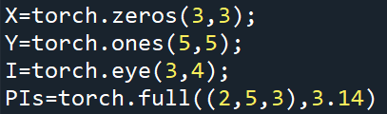
Tensor Construction
Torch uses separate arguments (instead of lists) for specifying dimensions, unlike numPy (but like np.random…)

Slide 18

Tensor Construction
Torch uses separate arguments (instead of lists) for specifying dimensions, unlike numPy (but like np.random…)

Slide 19

Automatic differentiation / AutoGrad
You need to specify which tensors you want gradients.
You don’t need gradients w.r.t. input data for instance
I had to specify that these are float-type to use gradients (not defined for int)
Alternatively I could have written 1.0, 2.0 etc.

Slide 20
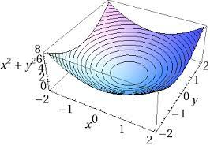
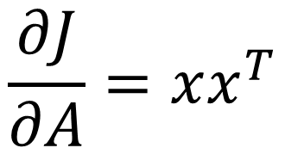
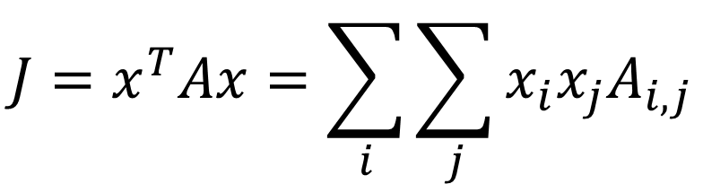
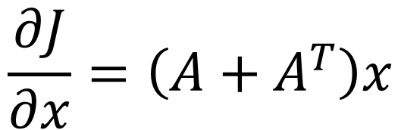
Demo: Quadratic Form
$$J=x^{T}Ax=\sum_{i}{\sum_{j}{x_{i}x_{j}A_{i,j}}}$$
$$\frac{∂J}{∂A}=xx^{T}$$
$$\frac{∂J}{∂x}=\left(A+A^{T}\right)x$$

Slide 21
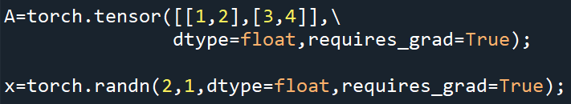


Demo: Quadratic Form

Slide 22



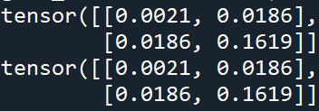
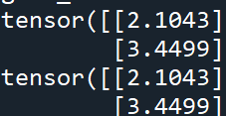
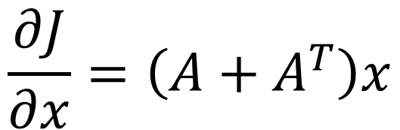
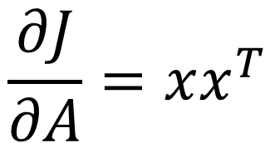
Demo: Quadratic Form
This call computes gradients and attaches to all of my related tensors (with requires_grad)!
$$\frac{∂J}{∂A}=xx^{T}$$
$$\frac{∂J}{∂x}=\left(A+A^{T}\right)x$$

Slide 23
Dataset Objects for Training
Data Array
PyTorch likes everything upfront in the dataset instead of specifying stuff later.
This is makes it easier to apply lots of models to the same data (minimal model specification)
PyTorch Tensor
Dataset Class
Data Loader

Slide 24
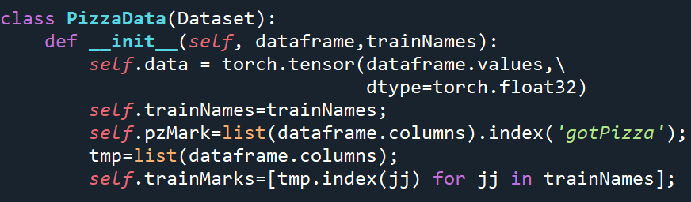

Dataset Class: 3 parts
__init__ (like everything else)
__len__

Slide 25
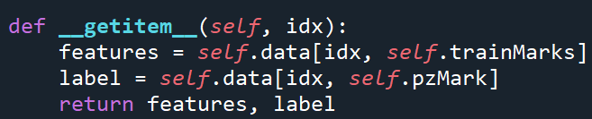

Dataset Class: 3 parts
3. __getitem__

Slide 26

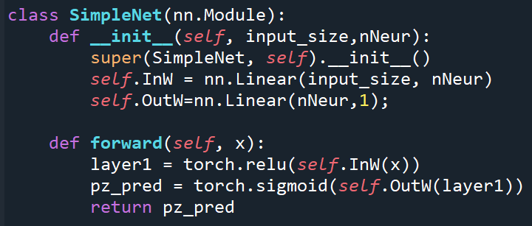
Let’s Make a Network
Two connection matrices
First nonlinearity is relu, second is sigmoid

Slide 27

Let’s Make a Network

Slide 28
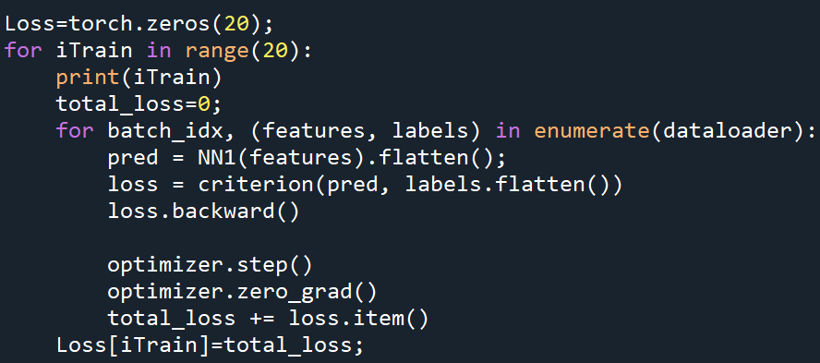
Let’s Make a Network

Slide 29
Your Turn!

Slide 30
Fin

